Slide 1



Business Insights 360
View in Power BI
Last data refresh:
5/1/2023 1:45:08 PM UTC
Downloaded at:
5/1/2023 2:47:53 PM UTC

Slide 2
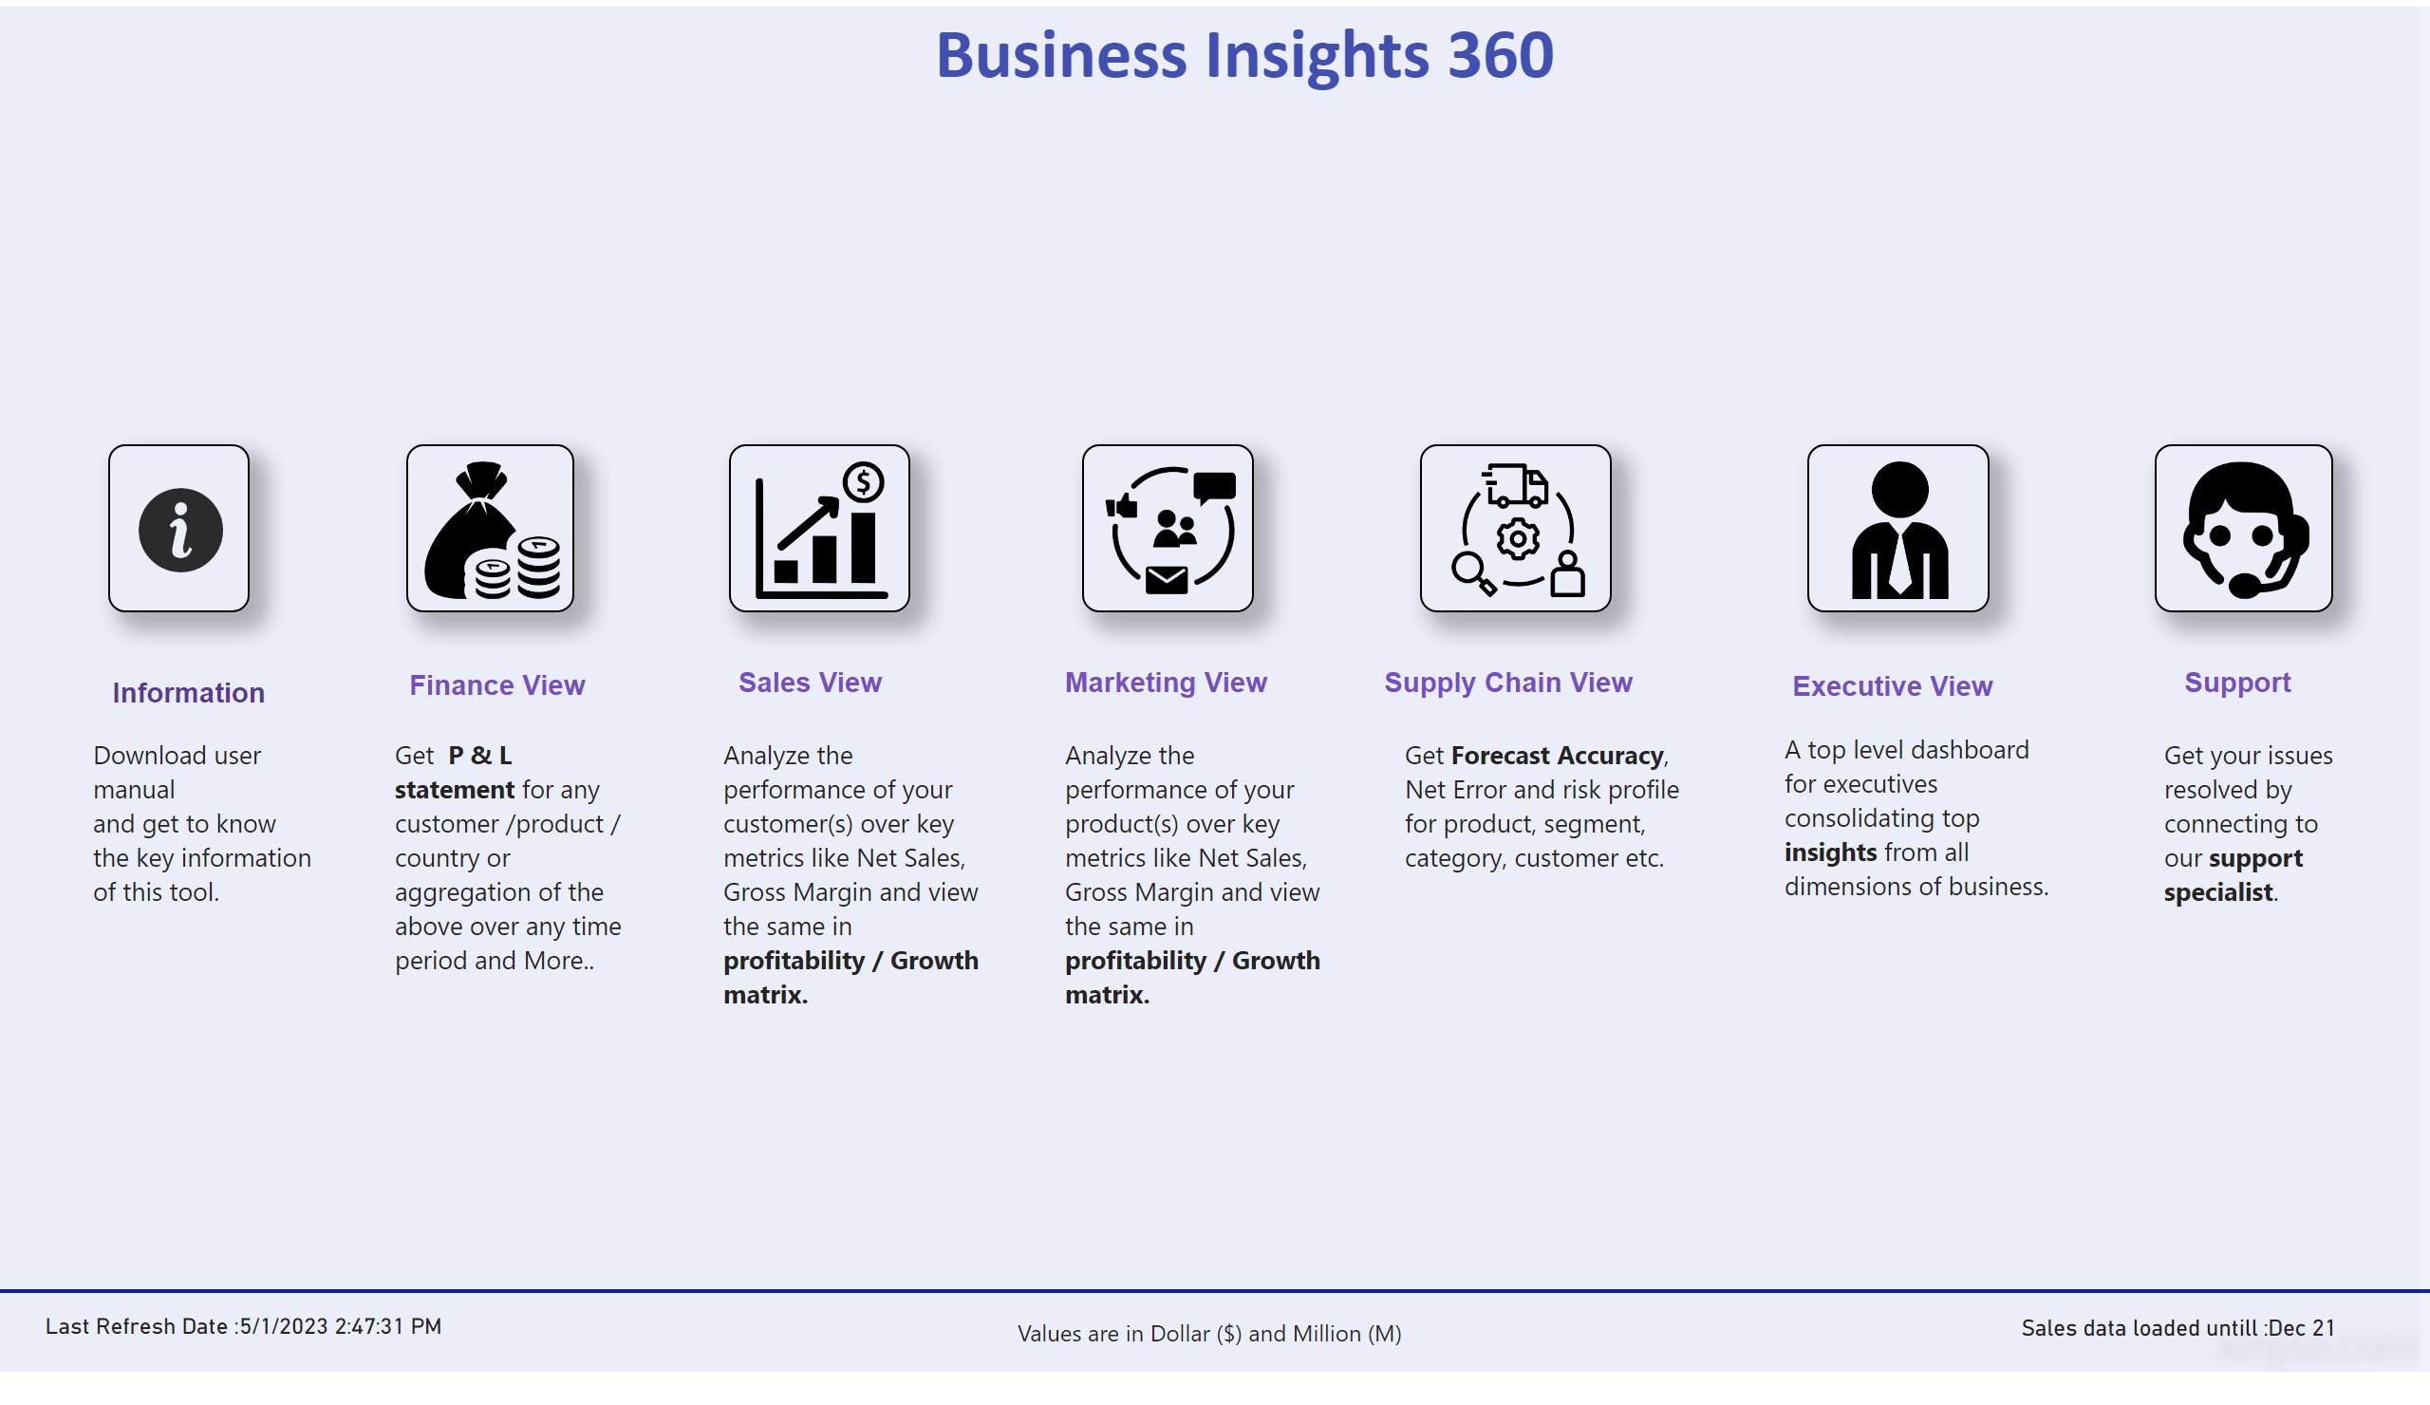
Home
Notes:
textbox
No alt text provided
image
No alt text provided
image
No alt text provided
image
No alt text provided
image
No alt text provided
textbox
No alt text provided
textbox
No alt text provided
textbox
No alt text provided
textbox
No alt text provided
textbox
No alt text provided
textbox
No alt text provided
textbox
No alt text provided
textbox
No alt text provided
image
No alt text provided
textbox
No alt text provided
textbox
No alt text provided
image
No alt text provided
textbox
No alt text provided
textbox
No alt text provided
image
No alt text provided
textbox
No alt text provided
textbox
No alt text provided
shape
No alt text provided
textbox
No alt text provided
card
No alt text provided
card
No alt text provided

Slide 3
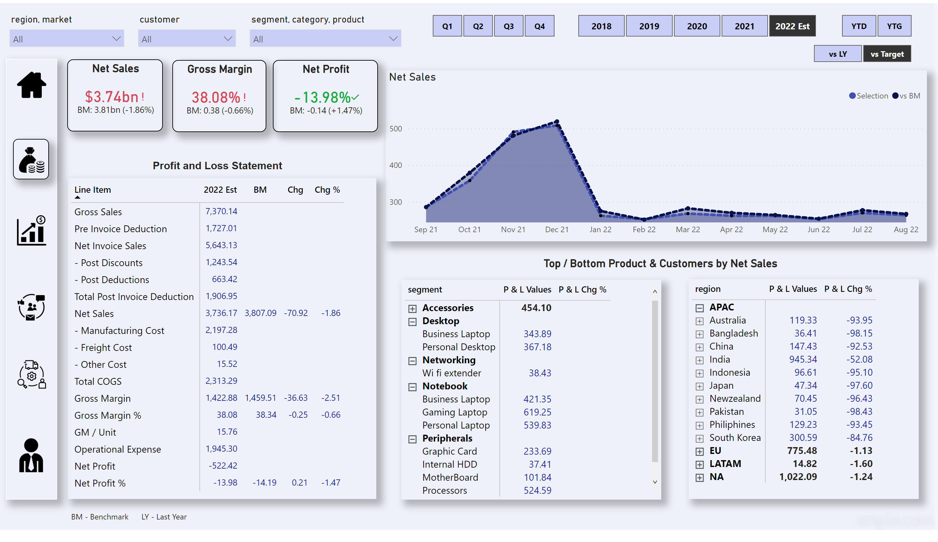
Finance View
Notes:
card
No alt text provided
slicer
No alt text provided
slicer
No alt text provided
slicer
No alt text provided
textbox
No alt text provided
image
No alt text provided
image
No alt text provided
image
No alt text provided
image
No alt text provided
image
No alt text provided
shape
No alt text provided
image
No alt text provided
card
No alt text provided
textbox
No alt text provided
slicer
No alt text provided
slicer
No alt text provided
slicer
No alt text provided
Net Sales
No alt text provided
pivotTable
No alt text provided
slicer
No alt text provided
pivotTable
No alt text provided
Net Sales
No alt text provided
Gross Margin
No alt text provided
Net Profit
No alt text provided
pivotTable
No alt text provided

Slide 4
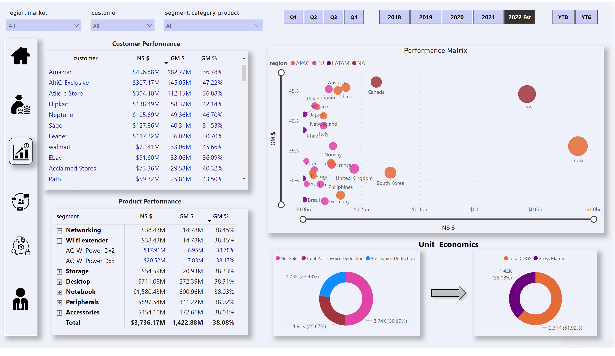
Sales View
Notes:
slicer
No alt text provided
slicer
No alt text provided
slicer
No alt text provided
image
No alt text provided
image
No alt text provided
image
No alt text provided
image
No alt text provided
image
No alt text provided
shape
No alt text provided
image
No alt text provided
shape
No alt text provided
textbox
No alt text provided
textbox
No alt text provided
textbox
No alt text provided
slicer
No alt text provided
slicer
No alt text provided
slicer
No alt text provided
pivotTable
No alt text provided
Performance Matrix
No alt text provided
tableEx
No alt text provided
donutChart
No alt text provided
donutChart
No alt text provided

Slide 5
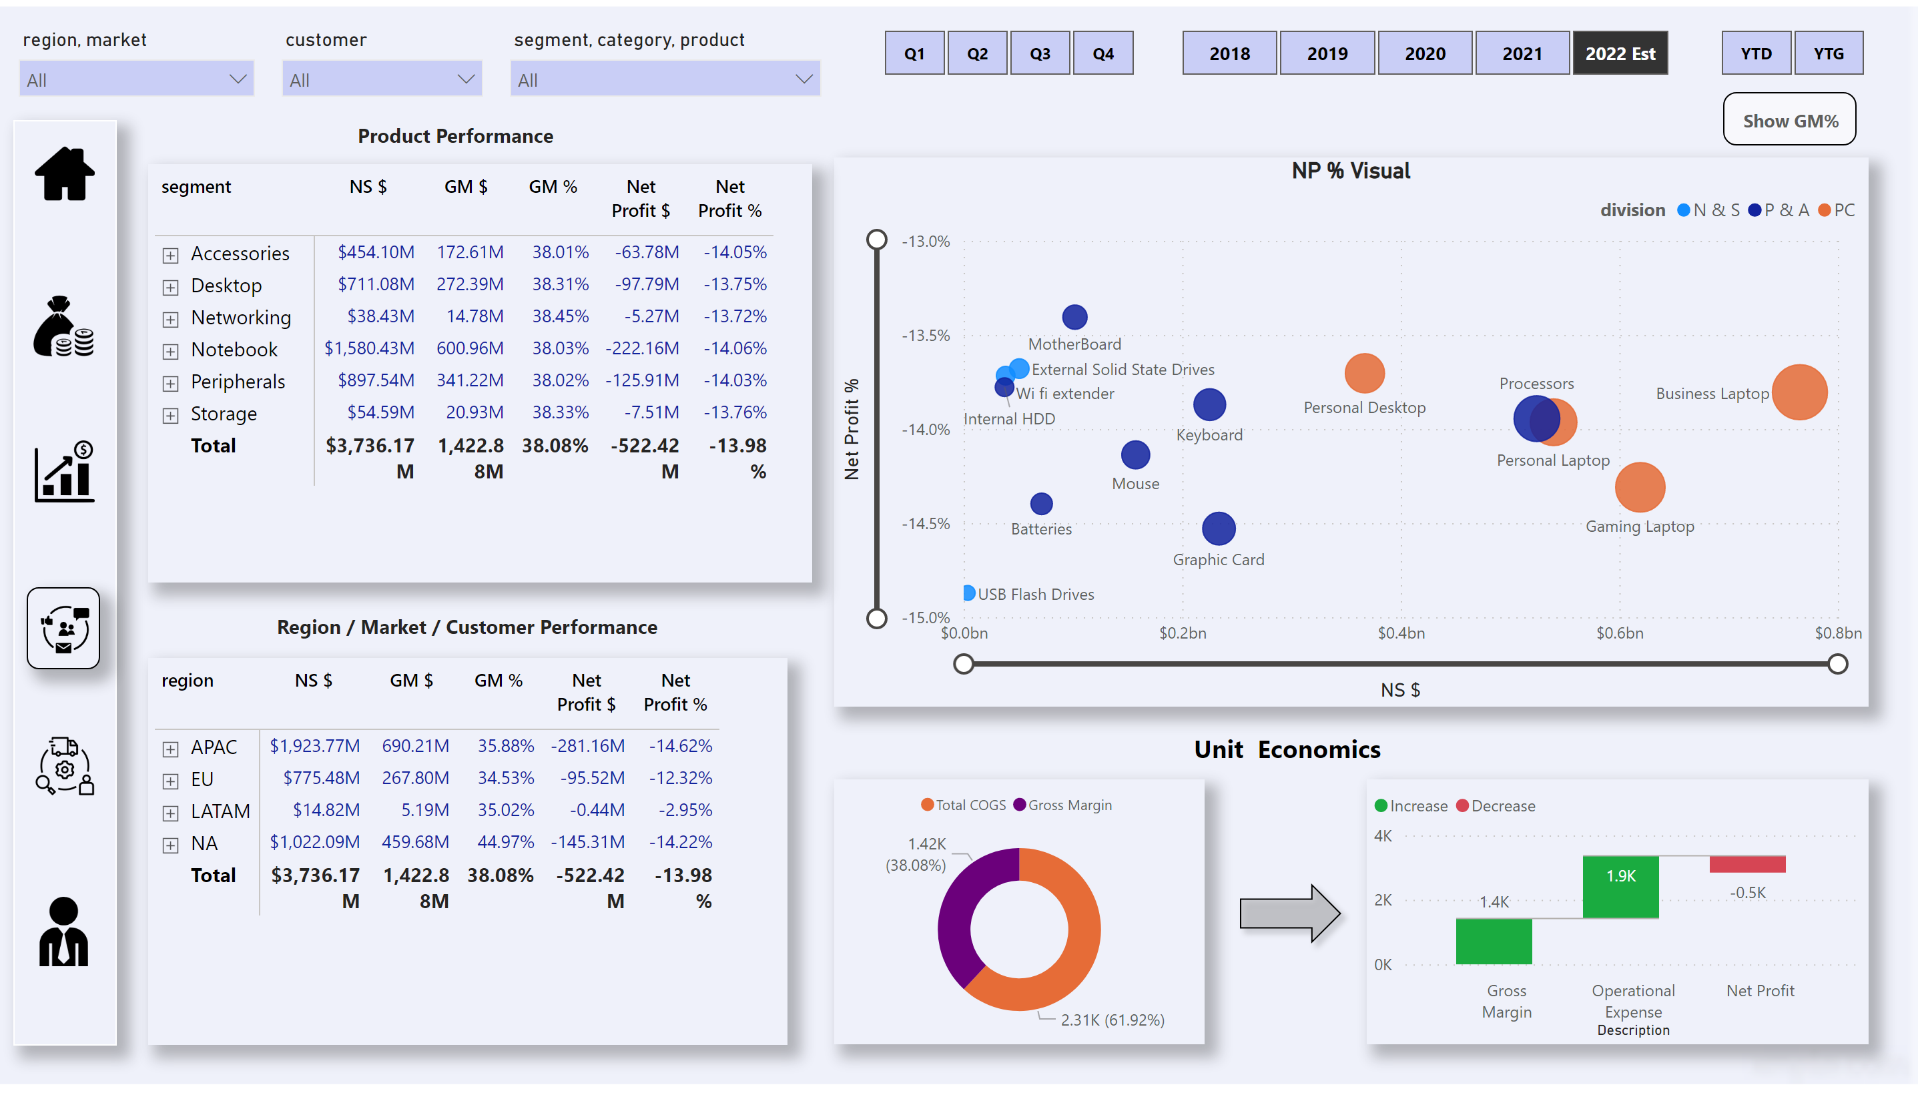
Marketing View
Notes:
slicer
No alt text provided
slicer
No alt text provided
slicer
No alt text provided
image
No alt text provided
image
No alt text provided
image
No alt text provided
image
No alt text provided
image
No alt text provided
shape
No alt text provided
image
No alt text provided
shape
No alt text provided
textbox
No alt text provided
textbox
No alt text provided
textbox
No alt text provided
pivotTable
No alt text provided
pivotTable
No alt text provided
waterfallChart
No alt text provided
GM% Button
No alt text provided
NP % Visual
No alt text provided
actionButton
No alt text provided
scatterChart
No alt text provided
slicer
No alt text provided
slicer
No alt text provided
slicer
No alt text provided
donutChart
No alt text provided

Slide 6
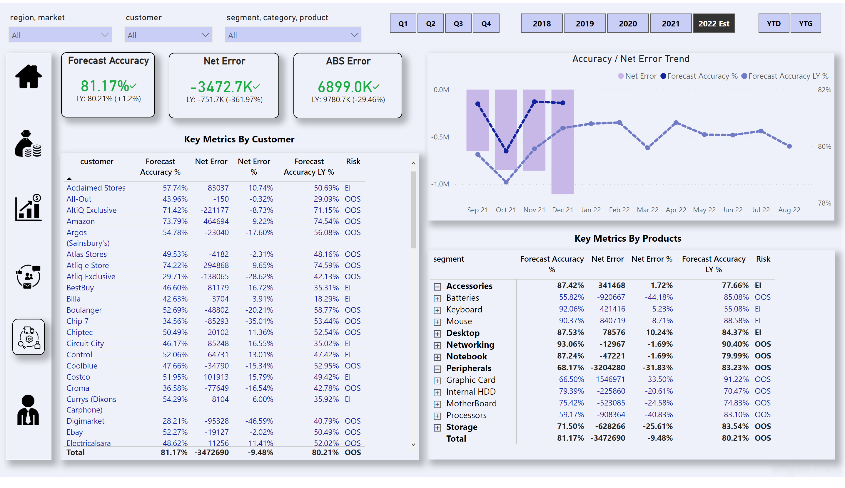
Supply Chain View
Notes:
slicer
No alt text provided
slicer
No alt text provided
slicer
No alt text provided
Forecast Accuracy
No alt text provided
Net Error
No alt text provided
ABS Error
No alt text provided
image
No alt text provided
image
No alt text provided
image
No alt text provided
image
No alt text provided
image
No alt text provided
shape
No alt text provided
image
No alt text provided
pivotTable
No alt text provided
tableEx
No alt text provided
Accuracy / Net Error Trend
No alt text provided
textbox
No alt text provided
textbox
No alt text provided
slicer
No alt text provided
slicer
No alt text provided
slicer
No alt text provided

Slide 7
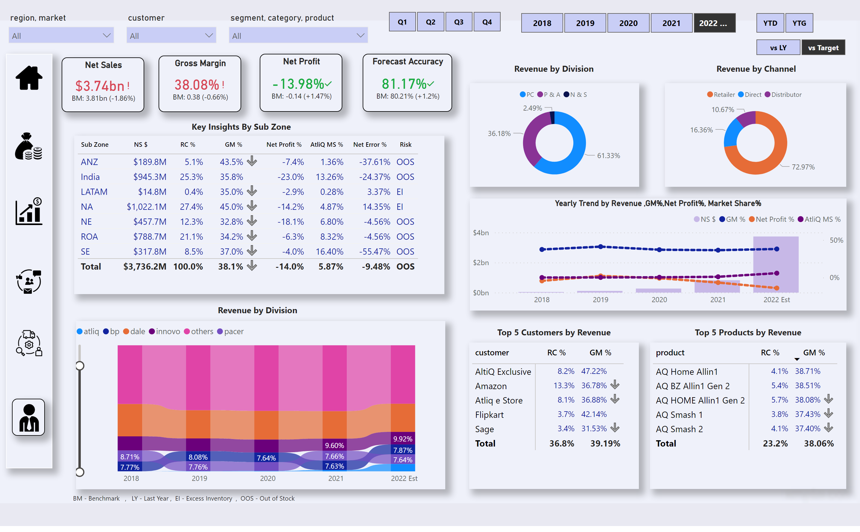
Executive View
Notes:
slicer
No alt text provided
slicer
No alt text provided
slicer
No alt text provided
image
No alt text provided
image
No alt text provided
image
No alt text provided
image
No alt text provided
image
No alt text provided
shape
No alt text provided
image
No alt text provided
pivotTable
No alt text provided
donutChart
No alt text provided
textbox
No alt text provided
Forecast Accuracy
No alt text provided
donutChart
No alt text provided
textbox
No alt text provided
tableEx
No alt text provided
textbox
No alt text provided
textbox
No alt text provided
Yearly Trend by Revenue ,GM%,Net Profit%, Market Share%
No alt text provided
ribbonChart
No alt text provided
textbox
No alt text provided
pivotTable
No alt text provided
textbox
No alt text provided
textbox
No alt text provided
slicer
No alt text provided
slicer
No alt text provided
slicer
No alt text provided
slicer
No alt text provided
Net Sales
No alt text provided
Gross Margin
No alt text provided
Net Profit
No alt text provided

